Slide 1
C++ Part II
X52.9265-01
Yedidiah Solowiejczyk
Week#2
New York University
School
of
Professional and Continuous Studies
2/27/11
C++ Part II

Slide 2
Synopsis
Classes
  Defining Classes and Member Functions
  Encapsulation
  Public, Private and Protected Members
  Accessor and Mutator Functions
  Structures vs. Classes
Constructors
Constructor Definitions
  Constructors with No Arguments
  Explicit Constructor Calls
  Default Constructor
EXAMPLE: Complex Number Class
Class Type Member Variables
Destructors
Destructor Definition
  Destructor with No Arguments
Copy constructors
  Copy Constructor Definition
More tools
  The const Parameter Modifier
    Inconsistent Use of const
  Inline Functions
  Static Members
  Nested and Local Class Definitions
Vectors
Preview of STL-Standard Template Library
Vector Basics
  Using Square Brackets
  Efficiency Issues
  Size vs. Capacity
  Member Functions
2/27/11
C++ Part II

Slide 3
Classes in C++
Classes in C++
  Collection of variables under a single name (name tag)
  Variables have different names and can be of different types
  Convenient way of grouping several pieces (members) of related information together
  Functions that manipulate data members are declared internally in the structure
  Member functions are defined via scoping (::) operator
  All member functions and data are private by default – public by choice (access control)
  Access data members and member functions via dot (.) operator
  Access to data implicitly uses this-> pointer
  Need not use typedefs to declare new type variables
  Interface Unit Test Driver Implementation
Access member function via dot operator
class student {
char name[32];
int id;
int grade:
int getGrade ( );
//member functions
public:
void setData(char *, int, int)
  :::::::::::::::::
  etc
};
int main( )
{
student X;
X.setData(“Joe Doe” , 12345, 98);
::::::::::::::::::::::::::::
return 0;
}
student::setData(
char*Name,
int Id,
int Grade)
{ strcpy(name,Name);
id = Id
grade = Grade;
}
2/27/11
C++ Part II

Slide 4
Class Properties
Class is full-fledged type!
  Just like data types int, double, etc.
Class can contain variables of various types
  int, float, char, double, ….. , object
Parameters of a class type are passed
  Pass-by-value
  Pass-by-reference
  Pass-by-pointer
Can use class type like any other type!
2/27/11
C++ Part II

Slide 5
Principles of OOP
Information Hiding
  Details of how operations work not known to "user" of class
Data Abstraction
  Details of how data is manipulated within
  ADT (Abstract Data Type)/class not known to user
Encapsulation
  Bring together data and operations, but keep "details" hidden
2/27/11
C++ Part II

Slide 6
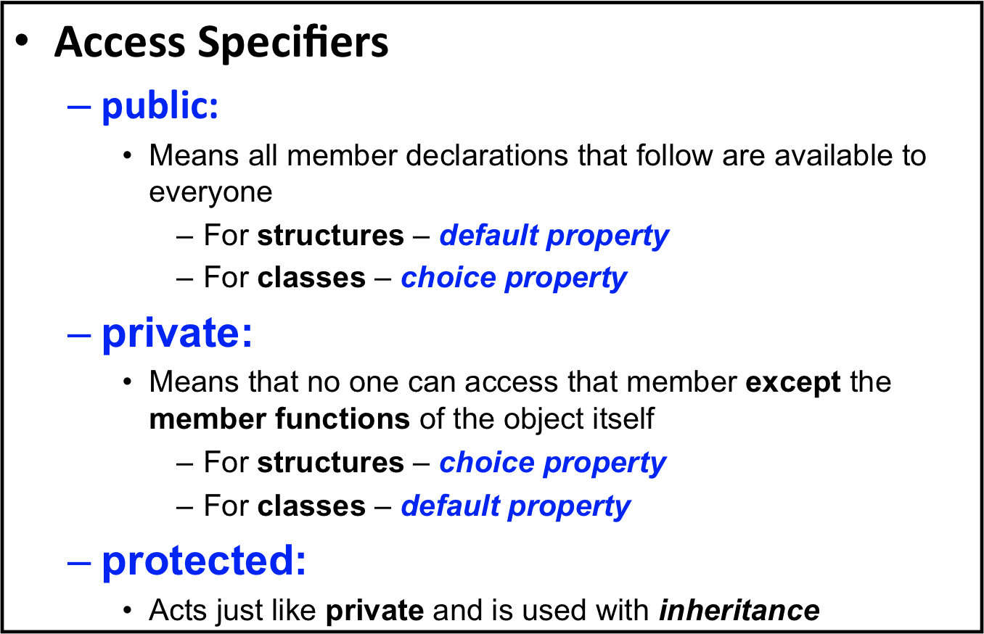
C++ Access Control
2/27/11
C++ Part II

Slide 7
Access Specifiers
struct student{
//public: //optional
//member functions
void setData(char *,
int id,
int grade);
int getGrade( );
etc
private: //choice
char name[32];
int id;
int grade;
};
class student{
//private: //optional
//protected:
char name[32];
int id;
int grade;
public: //choice
//member functions
void setData(char *,
int id,
int grade);
int getGrade( );
etc
};
2/27/11
C++ Part II

Slide 8
Access Specifiers
Example
class student{
public: //access specifier
void setData(char *, int, int);
int getGrade( ){return grade;}
int getId( ){return Id;}
char * getName( )
private: //access specifier
_x0016_ char name[40];
int id;
int grade;
};
2/27/11
C++ Part II

Slide 9
Public vs. Private Members
Data is almost always designated private in definition!
  Upholds principles of OOP (“information hiding”)
  Hides data from user (protects data….!!!!)
  Allow manipulation only via operations
    Which are member functions
Public items (usually member functions)
are "user-accessible"
2/27/11
C++ Part II

Slide 10
Private Member Functions???
Why would a class have a private member function?
  Clearly it is not accessible to the outside world…!
Example:
class FinInst {
char name[32];
int id;
float principal;
int rate;
int day, month, year;
int fday, fmonth, fyear;
int NumDays(int fDay,
int fMonth, fYear);
public: //member functions
void setData ( …..)
float getROI(int fDay,
int fMonth,
int fYear);
  ::::::::::::::::
};
int FinInst::NumDays( int Day,
int Month, int Year)
{
/*calculate #days between day of purchase and day of sale – skip leap days */
}
float ROI(int fDay, int fMonth, int fYear)
{
:::::::::::::::::::::::::
int totDays=NumDays( fDay, fMonth, fYear)
:::::
}
Ancillary function
2/27/11
C++ Part II

Slide 11
Struct & Class Scope Rules
Member variables and functions have unique scope properties in structs and classes
class student{
char name[32];
int id;
int grade;
public:
void setId(intiId);
etc
};
void student::setId(int Id)
{
id = Id;
}
class intern {
char name[32];
int id;
int grade;
public:
void setId(intiId);
etc
};
void intern::setId(int Id)
{
id = Id;
}
int main( )
{
int Id = 10;
student X;
intern Y;
X.setId(Id);
Y.setId(Id);
}
setId(Id) function calls are decoupled
2/27/11
C++ Part II

Slide 12
Dot & Scope Resolution Operator
Used to specify "of what thing" they are
members
  Dot (.) operator:
    Specifies member of particular (X) object
      X.getGrade( ); // object specific
  Scope resolution (::) operator:
    Instructs compiler "what class" member is from
      Student::getGrade( ){return grade;} //class specific
2/27/11
C++ Part II

Slide 13
Accessor and Mutator Functions
Accessor member functions
  "get member functions”
    Allow object to read data
    Simple retrieval of member data
Mutator member functions
  “set member functions”
    Allow object to change data based application
class student{
public: //member function
void setData(char *,
int id, int grade);
int getGrade( );
int getId( );
char * getName( );
private:
char name[32];
int id;
int grade;
};
2/27/11
C++ Part II

Slide 14
this -> pointer ^{ξ}
this -> pointer
  const Pointer that points to the current object.
  this -> is an implicit, hidden, first argument to all non-static member functions.
  this -> is always of the type “pointer to the current class”
  this -> stores the memory address of an object
  Two ways for member functions to access:
  student::getGrade{return grade;}
  student::getGrade{return this->grade;}
  Useful when using operator overload member functions
  ^{ξ – this_ptr.cpp}
2/27/11
C++ Part II

Slide 15
Constructors & Destructors
C++ provides classes with the following default member functions
  Constructors
    Responsible for the creation of objects when they are instantiated.
  Destructors
    Responsible for destroying objects when they go out of scope.
  Copy Constructors
    Create a new object as a copy of an existing object.
2/27/11
C++ Part II

Slide 16
Constructors
Constructors are responsible for
  Initialization of objects when they are declared
    Initialize some or all member variables
    Other actions possible as well (i.e. create data on the heap).
  A special kind of member function
    Automatically called when object is declared
      student X; // constructor member function invoked
  Can override default constructor with own definition
    student X(“Joe Blow”, Id, 98);
2/27/11
C++ Part II

Slide 17
Constructor Definitions
Constructors defined like any member function
Except:
  Must have same name as class
  Cannot return a value; not even void!
  Can be overloaded with or without arguments
class student {
char name[32];
int id;
int grade:
int getGrade ( );
// constructors
student(char*, int Id,
int Grade);
student( ); //default
//member functions
void setData(char *, int, int)
  :::::::::::::::::
  etc
};
student::student(char Name, int Id, int Grade)
{ strcpy(name,Name);
id = Id;
grade = Grade;
}
2/27/11
C++ Part II

Slide 18
Key Features - Constructors
Constructor name same as class itself!
class student{
private: ::::::::::::::::::::: //member data
public:
student( ); //default constructor
student (char *Name, int Id, int Grade); //overloaded constructor
int getGrade( );
};
Constructor declaration has no return-type
  Not even void!
Constructor in public section
  It’s automatically called when objects are declared
    student X or student X(“joe blow”, 1234, 88);
  If private, could never declare objects..!!! (????)
X.X(“joe” , , ,)
2/27/11
C++ Part II

Slide 19
Constructor Code Example
class student{
private: //member data
char *name; //pointer to char
int id;
int grade;
public:
student( ); //default constructor
student (char *Name, int Id,
int Grade);
//accessors & mutators
int getGrade( );
int getId( );
char * getName( );
etc
};
student::student( ) //default construct
{
name = NULL; //safe pointer
int id = 0;
int grade = 0;
}
//overloaded constructor
student::student (char *Name, int Id,
int Grade)
{
int len = strlen(Name);
name = new char[len + 1];
strcpy(name, Name);
id = Id;
grade = Grade;
}
2/27/11
C++ Part II

Slide 20
Alternate Constructor Code
class student{
private: //member data
char *name; //pointer to char
int id;
int grade;
const float PI;
public:
student( ); //default constructor
student (char *Name, int Id,
int Grade);
etc
};
student::student( ):PI( (float)3.14159 )
{ name = NULL;
id = 0;
grade = 0;
}
//overloaded constructor
//initialization Section
student::student (char *Name, int Id,
int Grade): id(Id), grade(Grade), PI( (float)3.14159 )
{
:::::::::::::::::::::::::::
}
Initialization section occurs before constructor is executed
Initialization section needs to be used when initializing constants data members and reference
Code will run faster with initialization section
2/27/11
C++ Part II

Slide 21
Overloaded Constructors
class student{
private: //member data
char *name; //pointer to char
int id;
int grade;
public:
student( ); //default constructor
student(char *Name);
student(char *Name, int Id);
student (char *Name, int Id,
int Grade);
etc
//accessors & mutators
:::::::::::::::::::::::::
};
Constructors can overload just like
other functions
Recall: function signature consists of:
  Name of function
  Parameter list
Provide constructors for all possible argument-lists
  Particularly "how many”
Examples:
  student X; //default constr
  student Y( “Joe”);
  student Z( “Joe”, 01234);
  student W( “Joe”, 01234, 95);
  //create 10 default students on heap
  student* p = new student[10];
2/27/11
C++ Part II

Slide 22
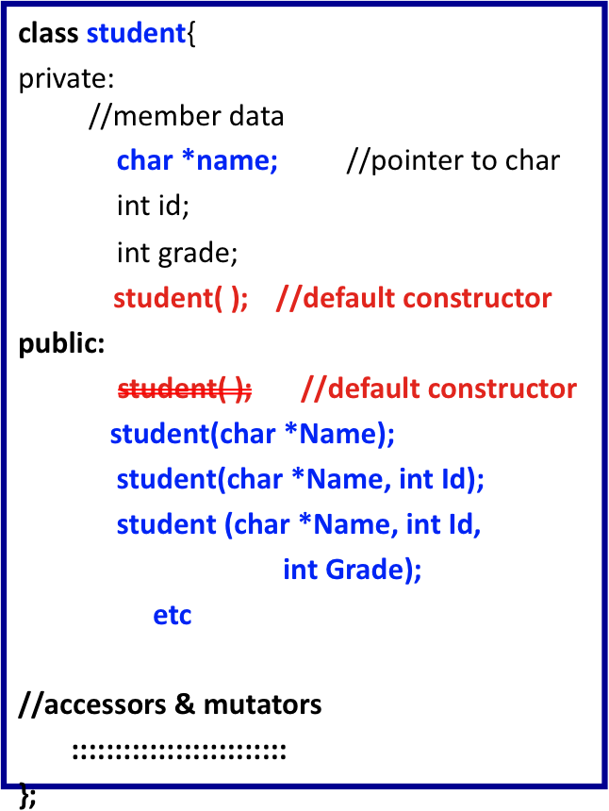
Suppressing Default Constructors
Examples:
  //compile error
  student X; // !NO
  student* p = new student;
  student Y( “Joe”);
  student Z( “Joe”, 01234);
  student W( “Joe”, 01234, 95);
You can prevent instantiation of default object by:
- Not including default constructor
- Private default constructor
* clear preferred method
2/27/11
C++ Part II

Slide 23
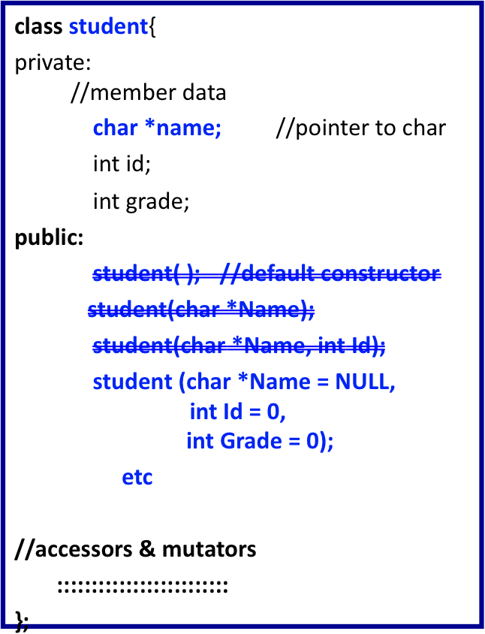
Overloaded Constructors – Default Parameters
Constructors can overload just like
other functions
Recall: function signature consists of:
  Name of function
  Parameter list
Provide constructors for all possible argument-lists
  Particularly "how many”
Examples:
  student X; //default constr
  student Y( “Joe”);
  student Z( “Joe”, 1234);
  student W( “Joe”, 1234, 95);
  etc
2/27/11
C++ Part II

Slide 24
Default Constructor
Defined as a constructor with no arguments
  student::student( )
One should always be defined
Auto-Generated?
  Yes & No
  If no constructors AT ALL are defined → Yes
  If any constructors are defined → No
If no default constructor:
  Cannot declare: Student X;
    With no initializers
2/27/11
C++ Part II

Slide 25
Constructor with No Arguments
Standard functions with no arguments:
  Called with syntax: callMyFunction( );
    Including empty parentheses
Object declarations with no "initializers":
  Student X; // This way!
  Student X(); // NO! – function that returns Student
    What is this really?
    Compiler sees a function declaration/prototype!
    Prototype for a function named X( ) that takes no arguments and returns a student object
Anonymous Object
  X = Student(“joe”, …,…);
2/27/11
C++ Part II

Slide 26
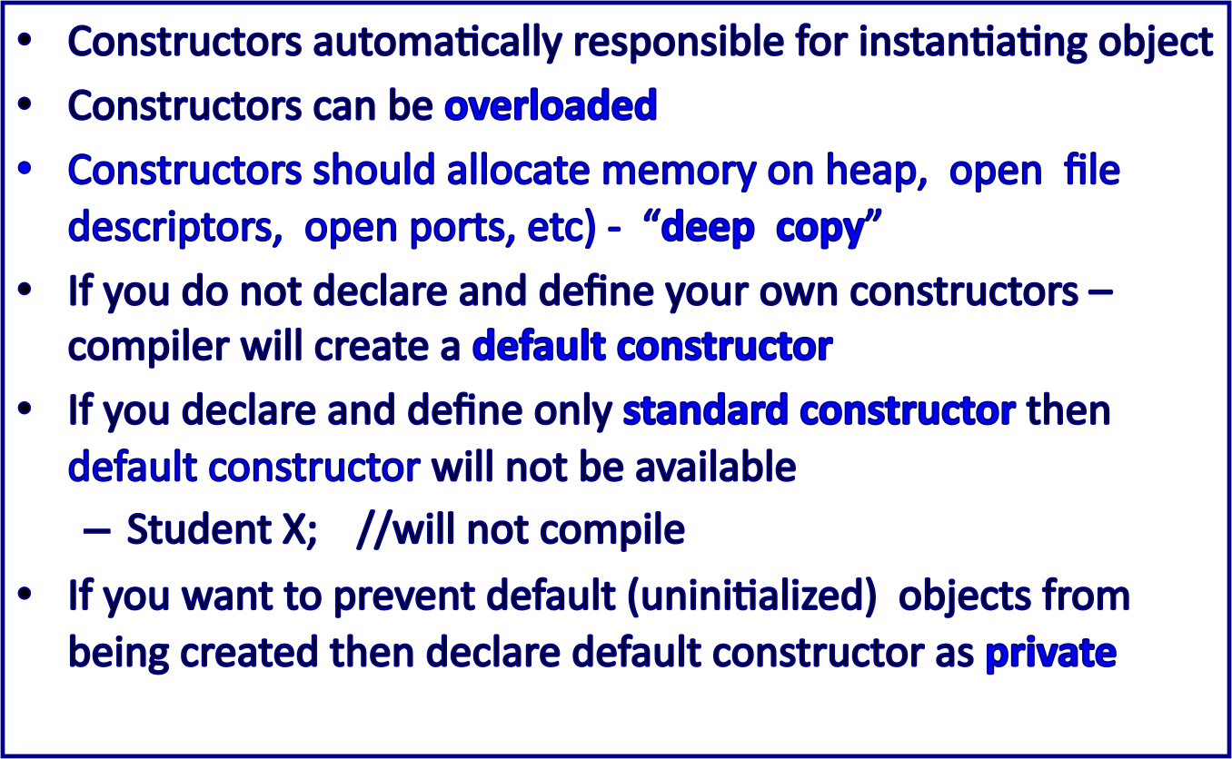
Constructors – Summary
2/27/11
C++ Part II

Slide 27
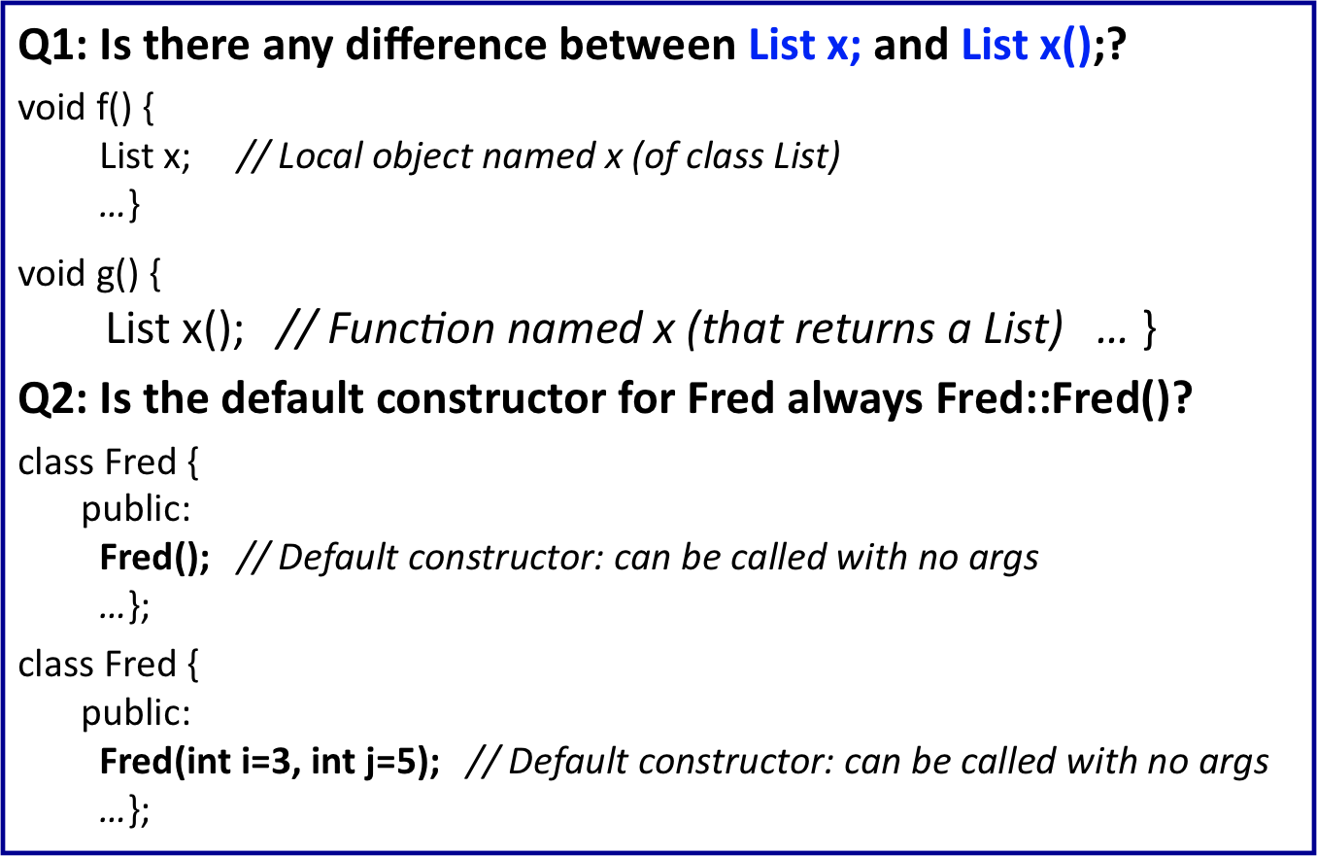
Constructors – FAQ
2/27/11
C++ Part II

Slide 28
Constructors – FAQ
Q3: Which constructor gets called when I create an array of Fred objects?
class Fred {
public:
( Fred);
...
};
int main(){
Fred a[10]; ← calls the default constructor 10 times
Fred* p = new Fred[10]; ← calls the default constructor 10 times
...
}
Q4: Should my constructors use "initialization lists" or "assignment"?
In fact, constructors should initialize as a rule all member objects in the initialization list.
A (inefficient) way to build constructors is via assignment, such as: Fred::Fred() { x_ = whatever; }. In this case the expression whatever causes a separate, temporary object to be created, and this temporary object is passed into the x_ object's assignment operator. Then that temporary object is destructed at the ;. That's inefficient.
2/27/11
C++ Part II

Slide 29
Destructors
Dynamically-allocated variables in objects
  Do not go away until "deleted”
Example:
class student{
char *name;
int id;
etc
public:
student(char *Name) //constructor
{
name = new char[(strlen(Name)+1];
strcpy(name, Name);
}
etc
};
Answer: Deallocate via destructor
If pointers are only private member data
They dynamically allocate "real" data
There must have means to "deallocate" when
object is destroyed (out of scope)
2/27/11
C++ Part II

Slide 30
Destructor
Opposite of constructor
  Automatically called when object goes out-of-scope
  Default destructor provided by compiler only removes ordinary variables from stack, not dynamic variables stored on the heap
  If you do not create your own destructor, compiler will provide default destructor that does not delete allocate heap memory ➔ memory leak
Defined like constructor, just add ~
  student::~student( )
  { //Perform delete clean-up duties
  delete [ ] name; //delete character pointer
  name = NULL; // make pointer safe
  }
only one definition of destructor!!
2/27/11
C++ Part II

Slide 31
Order of Destructors
int main( )
{
Student X; //default constructor #1
Student Y("Joe Doe", 1234, 95); // constructor #2
Student* Z_ptr = new Student; //default constructor #3
Student* R_ptr = new Student[3]; //default constructor #4, #5, #6
delete Z_ptr; //invokes destructor #3
delete [ ]R_ptr; //invokes destructor #4, #5, #6
//invokes destructor #2 on Y
//invokes destructor #1 on X
}
Destructors destruct in reverse order of constructors
2/27/11
C++ Part II

Slide 32
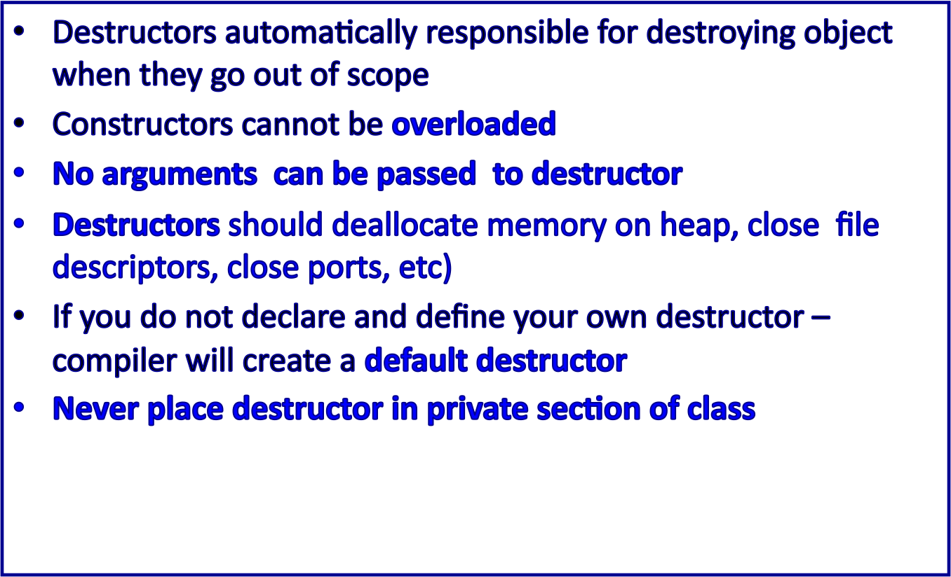
Destructors - Summary
2/27/11
C++ Part II

Slide 33
Destructors - FAQ
Q1: Can I overload the destructor for my class?
No, You can have only one destructor for a class Fred. It's always called Fred::~Fred(). It never takes any parameters, and it never returns anything.
You can't pass parameters to the destructor anyway, since you never explicitly call a destructor
Q2:What's the order that objects in an array are destructed?
void userCode(){
Fred a[10];
…}
the order for destructors will be a[9], a[8], ..., a[1], a[0]:
2/27/11
C++ Part II

Slide 34
Destructors - FAQ
Q3: When I write a destructor, do I need to explicitly call the destructors for my member objects?
No. You never need to explicitly call a destructor
A class's destructor (whether or not you explicitly define one) automatically invokes the destructors for member objects.
class Member {
public:
~Member();
...
};
class Fred {
public:
~Fred();
...
private:
Member x_;
Member y_;
Member z_;
};
Fred::~Fred()
{
// Compiler automagically calls z_.~Member()
// Compiler automagically calls y_.~Member()
// Compiler automagically calls x_.~Member()
}
2/27/11
C++ Part II

Slide 35
Copy Constructor
Copy Constructor is automatically called when:
  1. When an object is passed by value as a parameter to a function
  void foo( Student X);
  2. When an object is returned-by-value from a function
  Student goo( );
  3. When an object is created from another object of the same type
  Student X(“Joe Doe”, 123456, 96); //constructor invoked
  // copy constructor invoked
  Student Y(X); //create object from existing object _x0018_
  Student Z = X; ; //create object from existing object
Necessary to create "temporary copy" of object on the stack during function calls/returns
  Copy constructor creates it
2/27/11
C++ Part II

Slide 36
Copy Constructor
Copy constructor definition
All copy constructors take one parameter:
  a reference to an object of the same class
student( const student & rhs);
Compiler provides a default copy constructor with each class declaration
  Performs “shallow copy ” (bitwise copy of data members including pointers to heap)
  User defined copy constructor
    Performs “deep copy ” (bitwise copy of data members including reassignment of pointers to new heap location)
2/27/11
C++ Part II

Slide 37
Shallow Copy Constructor
class student{
private: //member data
char *name; //pointer to char
int id;
int grade;
public:
// constructor
student( );
student (char *Name, int Id,
int Grade);
~student( ); //destructor
//copy constructor – “shalllow”
student(const student &);
// other member functions
}
student::student():name(NULL),
id(0), grade(0){ ; }
student::student (char *Name,
int Id, int Grade):id(Id),
grade(Grade)
{
name = new char[strlen(Name)+1)];
strcpy(name, Name);
}
student:: ~student( ){delete [ ] name;}
//copy constructor student(const student &rhs)
{
name = rhs.name;
id = rhs.id
grade = rhs.grade;
}
student1
Heap
student1
Heap
student2
2/27/11
C++ Part II

Slide 38
Deep Copy Constructor
class student{
private: //member data
char *name; //pointer to char
int id;
int grade;
public:
// constructor
student( );
student (char *Name, int Id,
int Grade);
~student( ); //destructor
//copy constructor – “deep”
student(const student &);
// other member functions
}
student::student():name(NULL),
id(0), grade(0){ ; }
student::student (char *Name,
int Id, int Grade):id(Id),
grade(Grade)
{
name =
new char[strlen(Name)+1);
strcpy(name, Name);
}
student:: ~student( )
{delete [ ] name; name = NULL}
//copy constructor student(const student &rhs)
{ //delete [ ] name;
name =
new char[strlen(rhs.name)+1];
strcpy(name, rhs.name);
id = rhs.id
grade = rhs.grade;
}
student1
student2
student1
Heap
Heap
2/27/11
Heap
C++ Part II

Slide 39
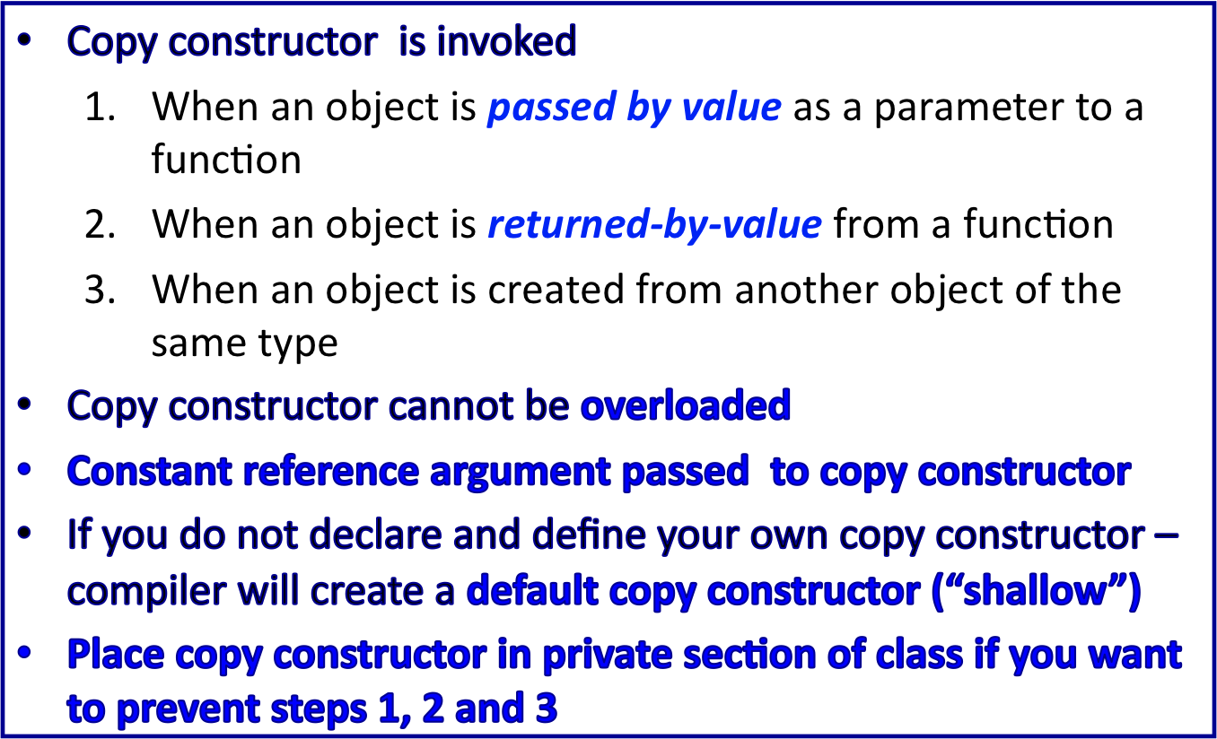
Copy Constructor - Summary
2/27/11
C++ Part II

Slide 40
Inline Functions
Inline functions
  Eliminates overhead of jumping execution to the function block of code
  More efficient, but only when short pieces of code are involved!
  Tradeoff on how many times the function is invoked vs. the cost of adding more code to the entire program
When a function is declared inline for non-member functions, the function is expanded at the calling block.
The function is not treated as a separate unit like other normal functions.
Compiler is free to decide, if a function qualifies to be an inline function.
Inline functions are safer than parametrized macro
2/27/11
C++ Part II

Slide 41
Inline Functions
Non-member function inline code
#include <iostream.h>
int Double(int );
int main( )
{
int target = 10;
target = Double(target);
target = 2*target; //compiler will substitute this code here
} // at execution, instructions already in place
inline int Double(int x) // saves a jump in the execution of the code
{
return 2*x;
}
2/27/11
C++ Part II

Slide 42
Inline Functions vs. Macro Definition
Example: Unsafe absolute macro
#define unsafe_abs(i) ( (i) >=0 ? (i): (-i) )
inline int safe_abs( int i ){ return ( i >= 0 ? i : -i ); }
void userCode(int x)
{
int ans;
ans = unsafe_abs(x++); //Error – x is incremented twice
ans = safe_abs(x++); //Correct – x is incremented once
} // before passed as argument
2/27/11
C++ Part II

Slide 43
Inline Functions
Member function inline code
  Any function you define inside a class definition is automatically an inline
Example
class student
char name[32];
int id;
int grade;
public:
int getId( ){return (id );} //inline #1
int getGrade( );
etc
};
inline int getGrade( ){return grade;} //inline #2
int main( )
{
student X(“joe”,123,87);
int Grade, Id;
::::::::::::::::::::::
Grade = X.getGrade( );
//Grade = grade;
Id = X.getId( );
// Id = id;
::::::::::::::::::::
}
2/27/11
C++ Part II

Slide 44
Static Members
Static member variables
  All objects of class "share" one copy
  One object changes it → all see change
Useful for "tracking"
  How often a member function is called
  How many objects exist at given time
Place keyword static before type
2/27/11
C++ Part II

Slide 45
Static Functions
Member functions can be static
  If no access to object data needed
  And still "must" be member of the class
  Make it a static function
Can then be called outside class
  From non-class objects:
    E.g., Server::getTurn();
  As well as via class objects
    Standard method: myObject.getTurn();
Can only use static data, functions!
2/27/11
C++ Part II

Slide 46
Vectors
Introduction
  Arrays: fixed size structures
  Vectors: "arrays that grow and shrink"
    During program execution
  Created from Standard Template Library
  (STL)
    Using template class
2/27/11
C++ Part II

Slide 47
Vector Basics
Similar to array:
  Has base type
  Stores collection of base type values
Declared differently:
  Syntax: vector<Base_Type>
    Indicates template class
    Any type can be "plugged in" to Base_Type
    Produces "new" class for vectors with that type
  Example declarations:
  vector<int> v; //integer numbers
  vector<double> X; //floating point numbers
  vector<complex> Z; // complex numbers
2/27/11
C++ Part II

Slide 48
Vector Basics
Similar to array:
  Has base type
  Stores collection of base type values
Declared differently:
  Syntax: vector<Base_Type>
    Indicates template class
    Any type can be "plugged in" to Base_Type
    Produces "new" class for vectors with that type
  Example declarations:
  vector<int> v; //integer numbers
  vector<double> X; //floating point numbers
  vector<complex> Z; // complex numbers
2/27/11
C++ Part II

Slide 49
Vector Use
vector<int> v;
  "v is vector of type int"
  Calls class default constructor
    Empty vector object created
Indexed like arrays for access
But to add elements:
  Must call member function push_back( )
    v.push_back(value);
Member function size( )
  Returns current number of elements
    N = v.size( );
2/27/11
C++ Part II

Slide 50
Vector Member Functions
  push_ack(T ) // add element (value T) to vector
  pop_back( ) // delete last valid element
  operator[n] // access element n
  front( ) // access first element
  back( ) // access last element
  empty() //Returns (bool) true if empty.
  size() //Returns # of elements of vector.
  resize(n, t=T()) // resize length of vector
  capacity() //Max # of elements allocated != size
  reserve(size_t n) //request change in capacity
  max_size() //Max # of vector elements (large)
  assign(n, T) //Assign first n elements value T
  insert(iterator, T)§ //Insert value n at element "iterator”
2/27/11
C++ Part II

Slide 51
Vector Example
#include <iostream>
#include <vector> //STL library
using namespace std;
int main( )
{
vector<int> v;
cout << "Enter a list of positive numbers.\n"
<< "Place a negative number at the end.\n”;
int next;
cin >> next;
while (next > 0){
v.push_back(next);
cout << next << " added. ”;
cout << "v.size( ) = " << v.size( ) << endl;
cin >> next;
}
cout << "You entered:\n”;
cout << "You entered:\n”;
for (unsigned int i = 0; i < v.size( ); i++)
cout << v[i] << " ”;
cout << endl;
return 0;
}
2/27/11
C++ Part II

Slide 52
Vector Efficiency
Member function capacity()
  Returns memory currently allocated
  Not same as size()
  Capacity typically > size
    Automatically increased as needed
If efficiency critical:
  Can set behaviors manually
    v.reserve(32); //sets capacity to 32
    v.reserve(v.size()+10); //sets capacity to 10 more
    than size
2/27/11
C++ Part II

